Slide 1
Measurement, Reporting, and Verification Working Group
Birdsey, Richard (WG Lead) | USDA Forest Service
Delgado Arias, Sabrina | Sigma Space
Domke, Grant | USDA Forest Service
Escobar, Vanessa | Sigma Space Corp.
Hagen, Stephen (Steve) | Applied Geosolutions
Houghton, Richard | Woods Hole Research Center
Hurtt, George | University of Maryland
Kang, Christine | UMD
Keller, Michael | USDA Forest Service
Kellndorfer, Josef | Woods Hole Research Center
Oda, Tomohiro (Tom) | USRA at NASA/GSFC
Stehman, Stephen (Steve) | SUNY College of Environ Sci & Forestry
Vargas, Rodrigo | University of Delaware
Williams, Christopher | Clark University

Slide 2
Goal of the MRV Working Group
To develop guidance for the NASA CMS program on how to integrate the different program elements, which are represented by many individual projects, into a cohesive program that addresses the most urgent Measurement, Reporting, and Verification (MRV) applications.
Or is it MRVV – Measurement, Reporting, Verification, and validation?
Or is it “monitoring” instead of “measurement”? Both?
Maybe it should be MMRVV for the CMS program?

Slide 3
There is a need for more attention to the “R” of MRV
IPCC Approach
What are the targets for reducing GHGs?
What are the reporting requirements globally or for different countries or regions?
What are the appropriate monitoring technologies?
CMS Approach

Slide 4
There is a need for more attention to the “V” of MRV
Verification: an independent framework for verifying the long-term effectiveness of REDD+ actions at different levels and by different actors (from Herold and Skutch 2009).
Essential for assessing progress and assuring compliance
This is a very complex topic politically at the national scale
May not be very practical at the project scale
Which of the CMS technologies are appropriate for verification in different contexts?
What about the second “V” – validation?

Slide 5
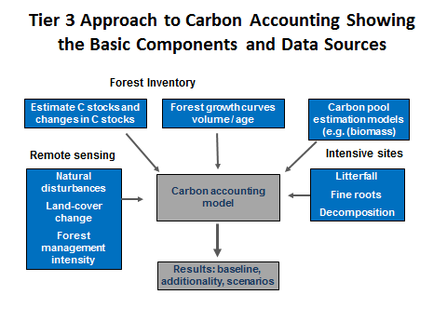
How will analysis and integration of data fit into CMS?
To date, most funded projects are focused on specific monitoring technologies (but see some new 2014 projects)
MRV requires integration of different monitoring data often by using models or model-data integration
How can CMS evolve to enhance synthesis of data for MRV applications?

Slide 6
What combinations of technologies are appropriate for different countries or scales (e.g., projects or nations)?
Different combinations are possible to deploy and are not likely to be the same in different contexts
Yet there is a need for consistency in reporting.
This could be a good link with the SilvaCarbon program, in the IPCC context
Should we develop one or a few case studies to illustrate the use of CMS monitoring technology for different MRV applications?

Slide 7
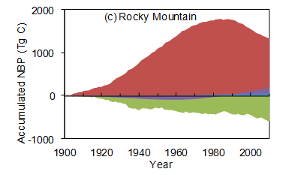
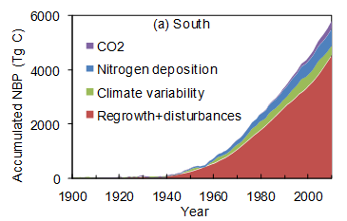
How can CMS technologies help attribute observed GHG changes to anthropogenic vs. natural causes?
This is one of the most important but difficult issues to address in operational MRV systems
The IPCC has not yet been able to provide guidance to countries about how to do this, other than to divide the world’s land using a proxy of “managed” and “unmanaged” land.

Slide 8
Results of MRV Survey – What is the Project Link to M, R, and/or V?
M | R | V | M,R | M,V | M,R,V
11 | 1 | 6 | 8 | 2 | 4
Significantly more V in 2013
Significantly more M,R,V in 2014

Slide 9
Results of MRV Survey -- Technology
Principal technology | Number
CO2 monitoring | 3
CO2 monitoring + inverse modeling | 3
Remote sensing | 4
Remote sensing + modeling | 3
Remote sensing + measurement | 7
Remote sensing + modeling + measurement | 2
Modeling + measurement | 4
Statistical analysis | 2

Slide 10
Results of MRV Survey -- Geography
Principal domain | Number
Global | 3
Global ocean (includes coastal) | 4
Global terrestrial | 1
North America | 3
USA | 2
USA regional | 9
Tropics regional | 4

Slide 11
Results of MRV Survey -- Policy
Principal domain | Number
International | 4
National GHG Inventories | 13
Land managers | 9
States | 5
Air quality agencies | 6
Project (markets) | 2+
National climate assessment | 2
Note: many projects listed multiple domains – these were counted separately

Slide 12
What the New MRV Working Group Hopes to Achieve at this Meeting
Review the CMS projects and their potential contribution to resolving some of the difficult issues that are encountered when designing MRV systems in various contexts around the world.
Identify a focused activity on one or a few of the most useful MRV-related tasks to support CMS.

